Slide 1
PHYSICAL PROPERTIES of polymers
By
Assistant lecturer
ABBAS ALBAWEE

Slide 2
Physical Properties of Polymers
Physical properties of polymers contain:
density
molecular weight.
degree of polymerization.
molar volume.
crystallinity of material.
Specific gravity.
Water absorption.
Water vapor permeability.
Contact Angle.
Rheology.
Viscosity.
Melt processing characteristics.
Melting point.
Cloud point.
Pour point ( transfer point).
Oil absorption of pigments.

Slide 3

Physical Properties of Polymers
Degree of Polymerization:
The degree of polymerization (DP)_{n} in a polymer molecule is defined as the number of repeating units in the polymer chain. For example:
In the case of polymers we talk about the average values of molecular weights because, polymer molecules are not
identical but are a mixture of many types with different degrees of polymerization, that is, with different molecular weights.

Slide 4
Physical Properties of Polymers
Molecular Weight Averages:
The physical properties (such as transition temperature, viscosity, etc.) and mechanical properties (such as strength, stiffness, and toughness) depend on the molecular weight of polymer. The lower the molecular weight, lower the transition temperature, viscosity, and the mechanical properties. Due to increased entanglement of chains with increased molecular weight, the polymer gets higher viscosity in molten state, which makes the processing of polymer difficult.

Slide 5

Physical Properties of Polymers
Suppose we have a set of values {x₁,x₂, …, x_{n}} and the corresponding probability of occurrence is given by {P₁, P₂, …, P_{n}}, then the average value is defined as follows:

Slide 6

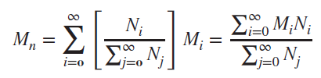
Physical Properties of Polymers
1. Number-Average Molecular Weight
Suppose we have a set of values {x₁, x₂, …, x_{n}} and the corresponding probability of occurrence is given by {P₁, P₂, …, P_{n}}, then the average value is defined as follows:
The number-average molecular weight is given by:

Slide 7


Physical Properties of Polymers
2. Weight-Average Molecular Weight
The weight-average probability is given by:
The weight-average molecular weight is given by:
The number-average molecular weight is less than the
weight-average molecular weight. The degree of polymerization can be calculated using the number-average molecular weight.

Slide 8
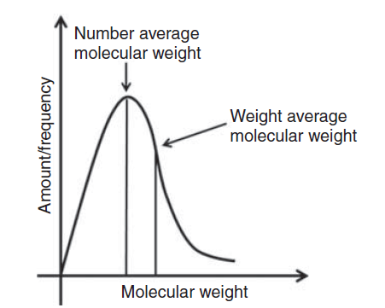

Physical Properties of Polymers
A typical plot showing the number-average and weight-average molecular weight is shown in Figure:
The degree of polymerization can be calculated using the number-average molecular weight.

Slide 9

Physical Properties of Polymers
Polydispersity Index or Heterogeneity Index
The ratio of the weight-average molecular weights to the number-average molecular weights is called polydispersity index (PDI) or heterogeneity index, which measures the polydispersity of the polymer mixture.
The dispersity measures heterogeneity of sizes of molecules or particles in the mixture. The mixture is called monodisperse if the molecules have the same size, shape, or mass. If the molecules in the mixture have an inconsistent size, shape and mass distribution, the mixture is called polydisperse. The natural polymers are generally monodisperse as all synthetic polymers are polydisperse with some exceptions. The PDI is equal to or greater than 1 where as the polymer chains approach uniform chain length, the PDI tends to unity.

Slide 10
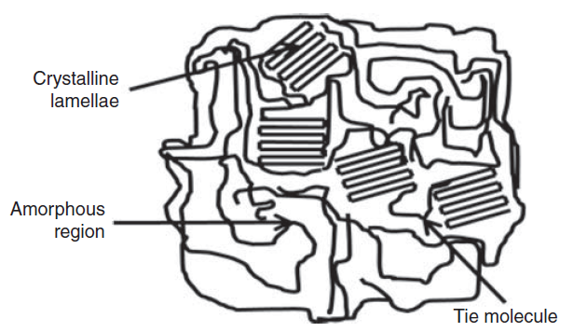
Physical Properties of Polymers
Polymer Crystallinity: Crystalline and Amorphous Polymers
The polymeric chains being very large are found in the polymer in two forms as follows:
1. Lamellar crystalline form in which the chains fold and make lamellar structure
2. Arranged in the regular manner and amorphous form in which the chains are in the irregular manner.
The lamellae are embedded in the amorphous part and can communicate with other lamellae via tie molecules (as in Figure). Polymer may be amorphous or semi-crystalline in nature.

Slide 11
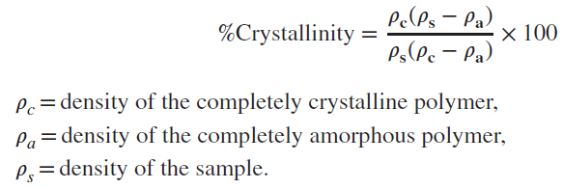
Physical Properties of Polymers
The %crystallinity is given by:
A typical range of crystallinity can be defined as amorphous (0%) to highly crystalline (>90%).
The polymers having simple structural chains as linear chains and slow cooling rate will result in good crystallinity as expected. In slow cooling, sufficient time
is available for crystallization to take place. Polymers having high degree of crystallinity are rigid and have high melting point, but their impact resistance is low. However, amorphous polymers are soft and have lower melting points. For a solvent, it is important to state that it can penetrate the amorphous part more easily than the crystalline part.
Examples of amorphous polymers: polystyrene and poly(methyl methacrylate).
Examples of crystalline polymers: polyethylene, and PET polyester.

Slide 12
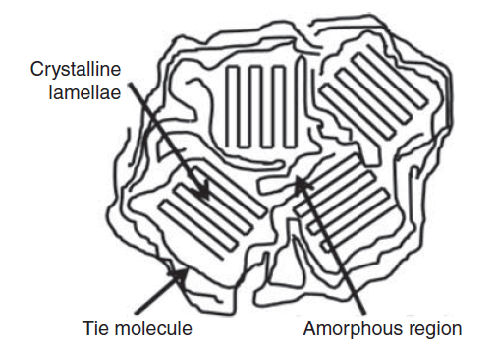
Physical Properties of Polymers
Spherulites:
If the molten polymer is cooled down, then the crystalline lamellae grow in radial direction from a nucleus along the three dimensions leading to a spherical structure called spherulite. The amorphous region is in between the crystalline lamellae (as in Figure). Spherulite formation and its diameter depend on various parameters such as the number of nucleation sites, polymer molecule structure and rate of cooling. Due to highly ordered lamellae in the spherulite, it shows higher density, hardness, tensile strength, and Young’s modulus. The elasticity and impact resistance are shown, because the lamellae are connected to amorphous regions.

Slide 13
Physical Properties of Polymers
THERMAL PROPERTIES OF POLYMERS
In the amorphous region of the polymer, at lower temperature, the molecules of the polymer are in, say, frozen state, where the molecules can vibrate slightly but are not able to move significantly. This state is referred as the glassy state. In this state, the polymer is brittle, hard and rigid analogous to glass. Hence the name glassy state. The glassy state is similar to a supercooled liquid where the molecular motion is in the frozen state.
The glassy state shows hard, rigid, and brittle nature analogous to a crystalline solid with molecular disorder as a liquid. Now, when the polymer is heated, the polymer chains are able to wiggle around each other, and the polymer becomes soft and flexible similar to rubber. This state is called the rubbery state. The temperature at which the glassy state makes a transition to rubbery state is called the glass transition temperature Tg. Note that the glass transition occurs only in the amorphous region, and the crystalline region remains unaffected during the glass transition in the semi-crystalline polymer.

Slide 14
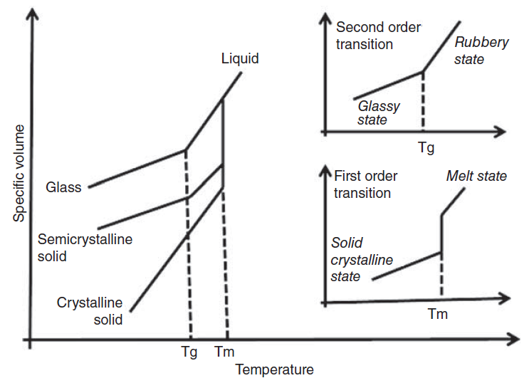
Physical Properties of Polymers
Glass Transition Temperature and Melting Point
The glass transition temperature is the property of the amorphous region of the polymer, whereas the crystalline region is characterized by the melting point. In thermodynamics, the transitions are described as first and second order transitions. Glass transition temperature is the second order transition, whereas the melting point is the first order transition (as in Figure). The value of glass transition temperature is not unique because
the glassy state is not in
equilibrium. The value of glass
transition temperature depends
on several factors such as molecular
weight, measurement method,
and the rate of heating or
cooling. Approximate values of
glass transition temperatures of
some polymers are listed in Table 1.

Slide 15
Physical Properties of Polymers
The semi-crystalline polymer shows both the transitions corresponding to their crystalline and amorphous regions. Thus, the semi-crystalline polymers have true melting temperatures (Tm) at which the ordered phase turns to disordered phase, whereas the amorphous regions soften over a temperature range known as the glass transition (Tg).
It should be noted that amorphous polymers do not possess the melting point, but all polymers possess the glass transition temperature.
The polymer melting point Tm is increased
if the double bonds, aromatic groups, bulky
or large side groups are present in the
polymer chain, because they restrict the
flexibility of the chain. The branching of
chains causes the reduction of melting
point, as defects are produced because
of the branching.

Slide 16
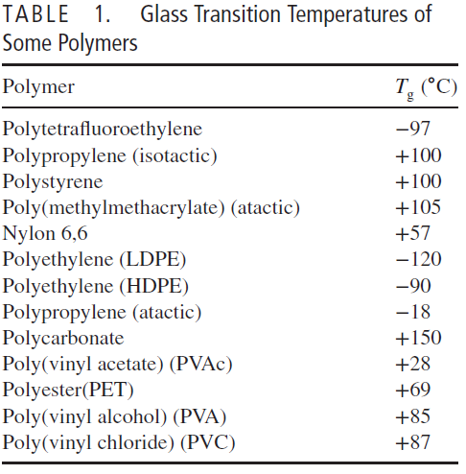
Physical Properties of Polymers

Slide 17
Physical Properties of Polymers
Factors Affecting the Glass Transition Temperature
The glass transition temperature depends on the mobility and flexibility (ease of the chain segment to rotate along the chain backbone) of the polymeric chains. If the polymeric chains can move easily, then the glassy state can be converted to the rubbery state at lower temperature, that is, the glass transition temperature is lower. If somehow the mobility of the chains is restricted, then the glassy state is more stable, and it is difficult to break the restriction causing the immobility of the polymer chains at the lower temperature, because more energy is required to make the chains free. Thus, in this case, the glass transition temperature is raised.
I.Intermolecular Forces: Strong intermolecular forces cause higher Tg. For example, PVC (Tg = 80 ∘C) has stronger intermolecular forces than polypropylene (Tg = −18 ∘C) because of the dipole–dipole forces from the
C—Cl bond.

Slide 18
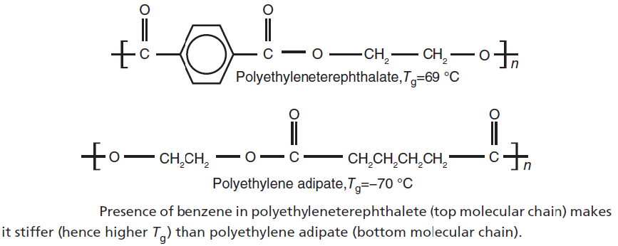
Physical Properties of Polymers
II. Chain Stiffness: The presence of the stiffening groups (such as amide, sulfone, carbonyl, p-phenylene etc.) in the polymer chain reduces the flexibility of the chain, leading to higher glass transition temperature. For example, polyethyleneterephthalete is stiffer than polyethylene adipate due to the presence of benzene ring (as in Figure). Therefore, Tg value is higher for polyethyleneterephthalate.
III. Cross-Linking. The cross-links between chains restrict rotational motion and raise the glass transition temperature. Hence, higher cross-linked molecule will show higher Tg than that with lower cross-linked molecule.

Slide 19
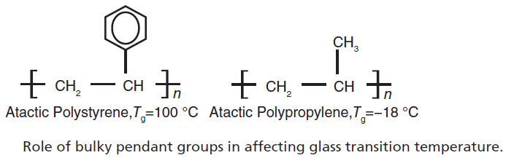
Physical Properties of Polymers
IV. Pendant groups. The presence of pendent group can change the glass transition
temperature.
(a) Bulky pendant groups: the presence of bulky pendant group, such as a benzene
ring, can restrict rotational freedom, leading to higher glass transition temperature. As in polystyrene, the presence of benzene ring increases the Tg (as in Figure). In polypropylene, there is no benzene ring that leads to lower Tg value (as in Figure).

Slide 20
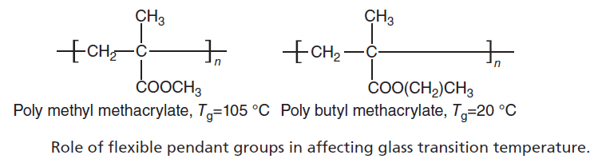
Physical Properties of Polymers
(b) Flexible pendant groups: the presence of flexible pendant groups, for example, aliphatic chains, limits the packing of the chains and hence increasesthe rotational motion, tending to less Tg value. In polybutylmethacrylate, the presence of large aliphatic chain reduces the Tg value when compared with that of polymethylmethacrylate (as in Figure).
V. Plasticizers. Plasticizers are low molecular weight and non-volatile materials added to polymers to increase their chain flexibility. They reduce the intermolecular cohesive forces between the polymer chains, which in turn decrease Tg.

Slide 21

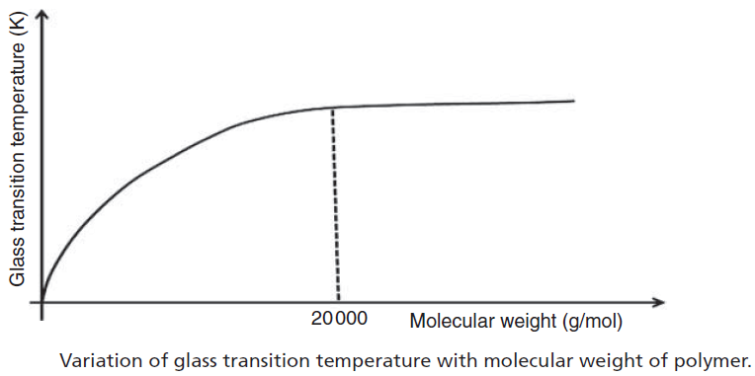
Physical Properties of Polymers
VI. Molecular Weight: The glass transition temperature is also affected by the molecular weight of the polymer (Fig. A1.8). Tg is increased with the molecular weight. The molecular weight is related to the glass transition temperature by the Fox–Flory Equation:
where Tg,∞ is the glass transition temperature at the molecular weight of infinity, and K is the empirical parameter called Fox–Flory parameter related to the free volume inside the polymer. It is observed that Tg is increased up to the molecular weight of approximately 20 000, and after this limit, the Tg is not affected appreciably.

Slide 22
References
A.A. Askadski, “Physical Properties of Polymers Prediction and Control”, G & B publishers, Moskow, 1996.
Robert O. E., “polymer science and technology, CRC Press, USA, 2000.
Sperling L.H., “Introduction to physical polymer science”, John Wiley & Sons, Inc. USA, 4th Ed. 1932.

